Slide 1
End-to-End application flow
PageRank and LDA

Slide 2
End-to-End application flow
Cleaning
Knowledge extraction
Consumption
Convert raw data to extract relevant information
Hadoop
Predict or compute relationship between data
GraphLab
Use derived information to solve a problem
Hadoop
Visualization

Slide 3
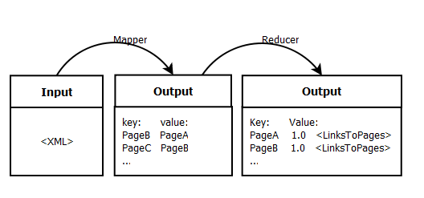
PageRank Cleaning
XML Page
<page>
<title>AccessibleComputing</title>
<redirect title="Computer accessibility" />
<sha1 />
<revision>
<id>381202555</id>
<contributor>
<username>OlEnglish</username>
<id>7181920</id>
</contributor>
<minor />
<comment> … </comment>
<text xml:space="preserve">#REDIRECT
[[Computer accessibility]]
{{R from CamelCase}}</text>
</revision>
</page>
Map Function
Set input format as XML
Set page marker for each document
Grep document title use a key
Filter links from document text
Create a <key, value> pair of <title, page link>
Example:
AccessibleComputing Computer_accessibility
Reduce Function
Group all values against in key in single line.
Initialize ranking value for each page (user input)
Example:
AccessibleComputing 1.0 Computer_accessibility
What output format preferred for Graph checking/partitioning?

Slide 4
LDA Cleaning
XML Page
<page>
<title>AccessibleComputing</title>
<redirect title="Computer accessibility" />
<sha1 />
<revision>
<id>381202555</id>
<contributor>
<username>OlEnglish</username>
<id>7181920</id>
</contributor>
<minor />
<comment> … </comment>
<text xml:space="preserve">#REDIRECT
[[Computer accessibility]]
{{R from CamelCase}}</text>
</revision>
</page>
Map Function
Set input format as XML
Set page marker for each document
Grep document title
Grep word, ensure it is not a stop word
Create a hash function for words to keep frequency count or use combiner function
Output <key, value> pair of <word, frequency title>
Example:
Computer 1 AccessibleComputing
Reduce Function
Reducer get input partition for a given word
TF-IDF requires
# occurrences * log( total # of documents / # of documents containing that word )
Total # of document requires separate Map-Reduce to count, or user input
Example:
Question: How do you calculate Latent factor for word/document?

Slide 5
Ingress requirement of GraphLab
Vertices and edges has to be integer numbers
How do you keep the hash of integer id to data?
Is Map-Reduce is right method to achieve that? If so how to assign global values in parallel.
De-duplication/cleaning requirements
Partitioning

Slide 6
Intermediate data approaches
Pairs
Emit (a, b) -> count
Stripes
(a, b) -> 1
(a, c) -> 3
…
a -> {b:1, c:3, …}

